Slide 1



E-Tab Tournament! Mondays at 7pm!
Sponsored by
ARROW gaming
No purchases are required

Slide 2

Balloon party night is NOVEMBER 15th AT 7pm! Come ready to puRCHase and have a great night!!

Slide 3
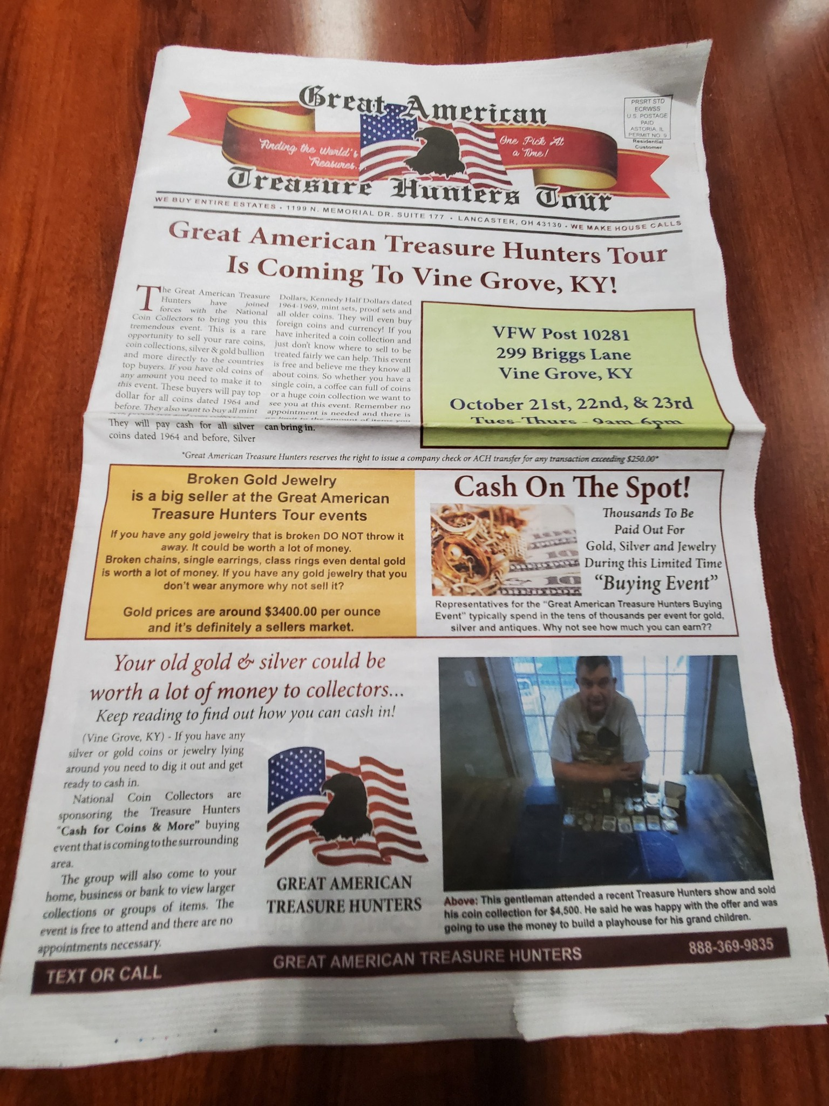
GREAT AMERICAN TRESURE HUNTERS TOUR OCTOBER 21,22,23 9:00 AM TO 6:00 PM IN THE HALL

Slide 4

Join us Tuesday Nights at 7:00 PM for cornhole!!

Slide 5


VFW BREAKFAST!
eVERY SATURDAY
8-11 AM
YOU CAN’T GET A BETTER DEAL THAN THIS!
OPEN TO EVERYONE

Slide 6


Community Breakfast! 16 NOVEMBER 2025 at 11am
All volunteers needed by 9 am

Slide 7
E TABS
TICKETS MUST REDEEMED WITHIN 24 HOURS OF END OF GAMING SESSION
IF TICKET IS NOT REDEEMED PLAYER WILL FORFEIT WINNINGS

Slide 8
WARNING TO MINORS
Persons under the age of 21 are subject to a two hundred dollars if they
1- Enter licensed premises to buy, or have served to them, alcoholic beverages
2-Possess, purchase or attempt to purchase, or get another to purchase alcoholic beverages for them.
Anyone aiding or assisting a person under 21 in purchasing alcoholic beverages is also subject to a fine not to exceed two hundred fifty dollars
3-Misrepresent their age for the purpose of purchasing or obtaining alcoholic beverages
KY. DEPT. OF ALCOHOLIC BEVERAGE CONTROL

Slide 9

100% Smoke free
This includes vapes and chewing tobacco
There are multiple smoking areas outside for your convenience
Thank you!

Slide 10



Nerd Night/Potluck VFW 10281Thursday
^{OCTOBER OCTOBER 30TH}

Slide 11
Recommendations? Or suggestions to improve the Environment FOR OUR VETERANS AND POST. PLEASE LET US KNOW

Slide 12
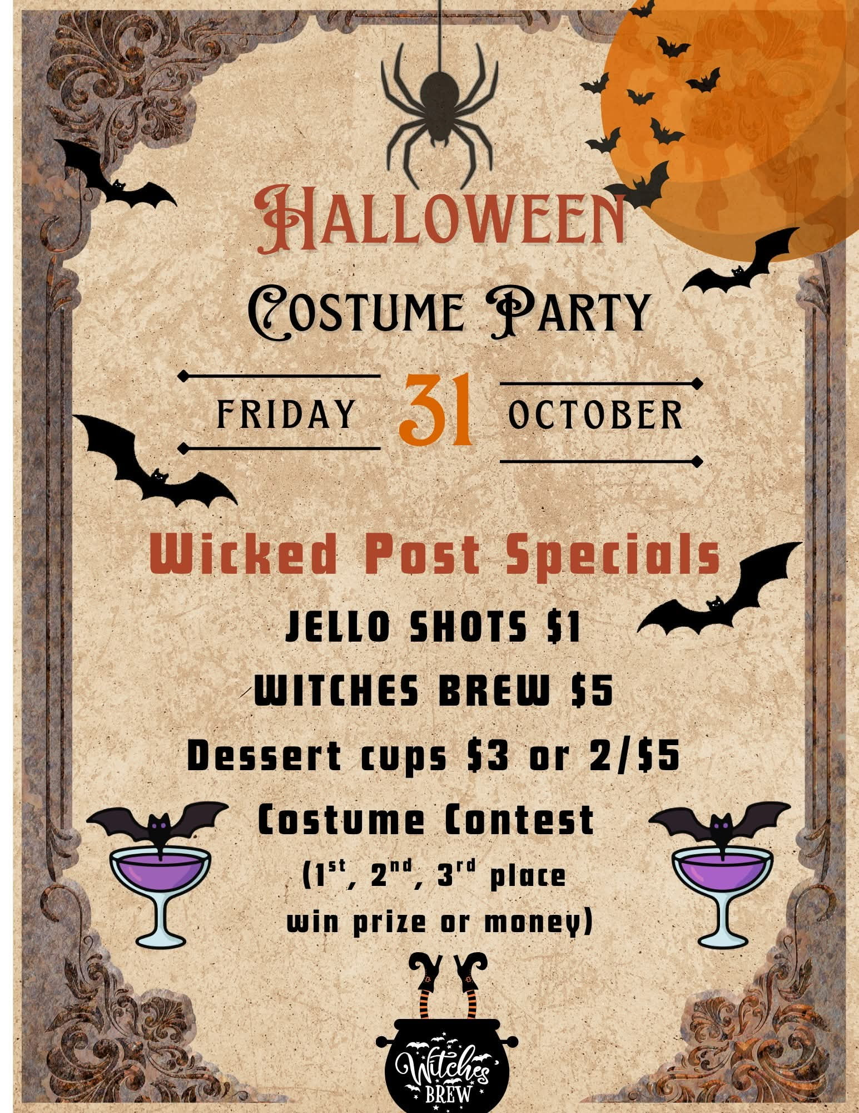
WICKED ADULT HALLOWEEN PARTY
COSTUME CONTEST 1ST,2ND,3RD,
OCTOBER 31ST PARTY STARTS 7:00PM
COSTUME CONTEST STARTS AT 9:00PM

Slide 13
FUNERAL SERVICES

Slide 14
MEMBERS IN NEED
DON CAMPBELL SIGNATURE HEALTH ELIZABETHTOWN
ROOM 404
HE WANTS YOU TO VISIT

Slide 15
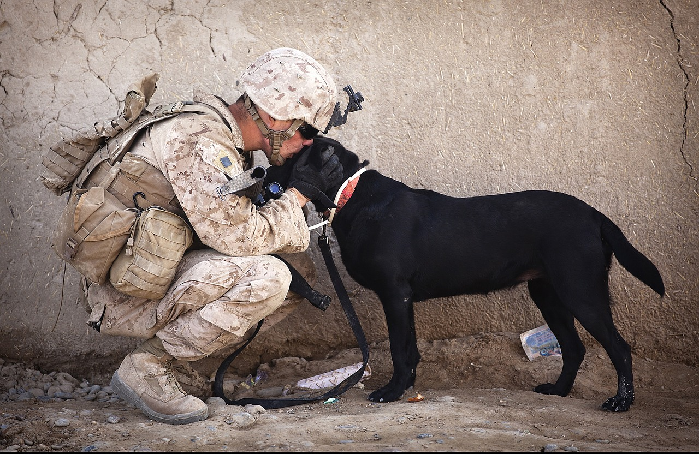
NO DOGS OR OTHER PETS ALLOWED
THIS INCLUDES EMOTIONAL SUPPORT, COMPANION AND THERAPY ANIMALS
EXEPT FOR GUIDE DOGS SIGNAL DOGS AND SERVICE ANIMALS WITH CERTIFIED DOCUMENTS IN HAND
WE APPRICIATE YOUR UNDERSTANDING

Slide 16
ORDER OF SERVICE AT THE CANTEEN, IS AS FOLLOWS
1. ALCOHOL
2. FOOD
3. GAMING
4. ALL ETABS MUST BE TURNED IN BY CLOSE OF BUSINESS THE DAY OF PLAY.

Slide 17

TURKEY SHOOT 4 OCTOBER 2025 TO MARCH 2025

Slide 18
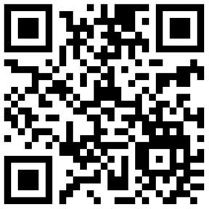

PATRIOT'S PEN AND VOICE OF DEMOCRACY
Post 10281
2025-2026 COMPETITION
"VFW made it possible for me to go to college."
- Rachel 2020 Prize Winner
ELIGIBILITY
APPLICATION DEADLINE:
OCTOBER 31, 2025
Students must be lawful U.S. permanent residents or have applied for permanent residence (for which the application has not been denied) and intend to become a U.S. citizen at the earliest opportunity.
PATRIOT'S PEN
Open to 6th, 7th and 8th grade students enrolled by the Oct. 31st deadline
Submit a 300 – 400-word essay
This year’s theme is, “How are you showing patriotism and support for our country?”
National Prize is currently $5,000
bit.ly/4o5HDZY
VOICE OF DEMOCRACY
Open to students in grades 9-12 enrolled by Oct. 31st deadline
Submit a 3–5-minute audio and written essay This year’s theme is, “How are you showing patriotism and support for our country?”
National Prize is currently $35,000
bit.ly/4m0VQVT
https://scholarsapp.com

